Slide 1
Intuit Craft Demo: Hiring Portal

Slide 2
Introduction
Myself P S K Abdul Nawaz having 7.6 years of experience in front end development in technologies Angular, ReactJS, Typescript, JavaScript, HTML5, CSS3, jQuery, Bootstrap, Ajax, High Charts, and Web components.
Currently working as Senior Manager at Morgan Stanley India Pvt Ltd, Bangalore.
Employment Experience:
Senior Manager at Morgan Stanley India Pvt Ltd. (06/2022 - Present)
Senior Associate Experience Technology L1 at Sapient Consulting Pvt Ltd. (04/2020 - 06/2022)
Software Engineer UI at Azuga Telematics Pvt Ltd. (09/2019 - 03/2020)
Associate at Cognizant Technology Solutions. (11/2015 - 09/2019)

Slide 3
Craft Demo: Hiring Portal High Level Design
Hiring Portal is a job portal where people can view/ post, contract jobs to be performed. There are two sections to this portal: Freelancer, Employer.
Tech Stack Used: React JS, JavaScript, HTML, CSS.
Libraries & Packages Used: React, React DOM, React Router DOM, Formik, Yup, React Redux, Redux Toolkit, React Switch, React Input Tags.
Assumptions: Freelancer/Employer can be anyone with a valid Email Id & Password of min 6 characters. No real time API’s integrated, no session management in backend.
Stretch Goals: Dark mode, RWD

Slide 4
Hiring Portal: Freelancer Section Features
Profile Creation / Sign Up: Create a professional profile showcasing your skills, experience, and portfolio and adding GitHub projects to his profile.
Login Page: Login as a freelancer with email and password.
Form Validations: Basic form validations for signup and login fields.
Job Search: Access a diverse range of contract jobs posted by employers across industries and search them using skills or min salary/hour.
Application Submission: Submitting applications for jobs that match their skills and interests with single click.

Slide 5
Hiring Portal: Employer Section Features
Profile Creation / Sign Up: Create a Employer profile by singing up.
Login Page: Login as an Employer with the credentials email and password
Form Validations: Basic form validations for signup and login fields.
Job Posting: Create detailed job listings with project descriptions, required skills, and budget.
Jobs View: Able to see the jobs posted by the employer and the applications for those jobs
User Profile View: Able to see the applicants user profile by clicking on View Applicants on a particular job posting.

Slide 6
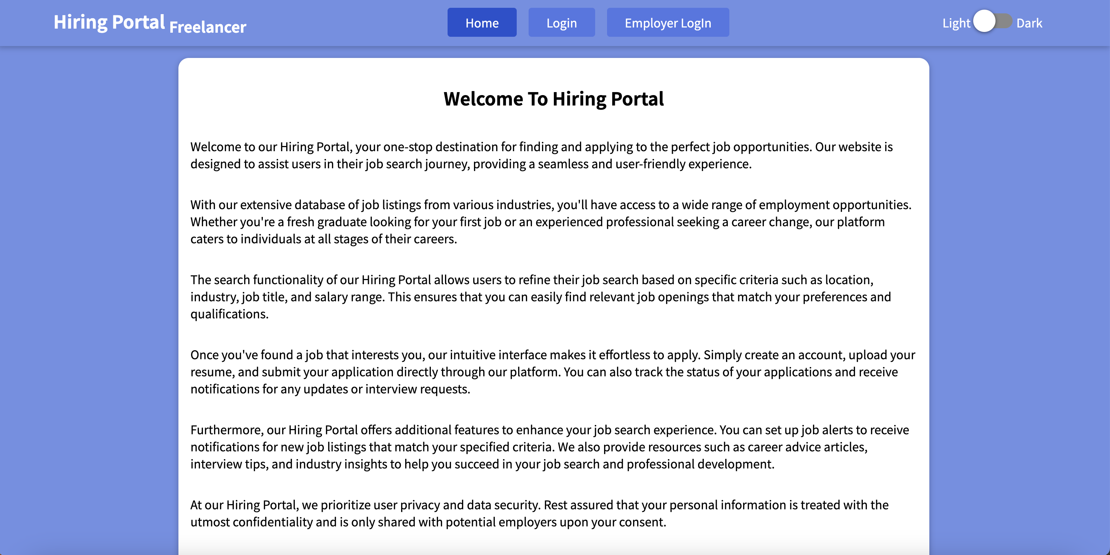
Hiring Portal Snapshots

Slide 7
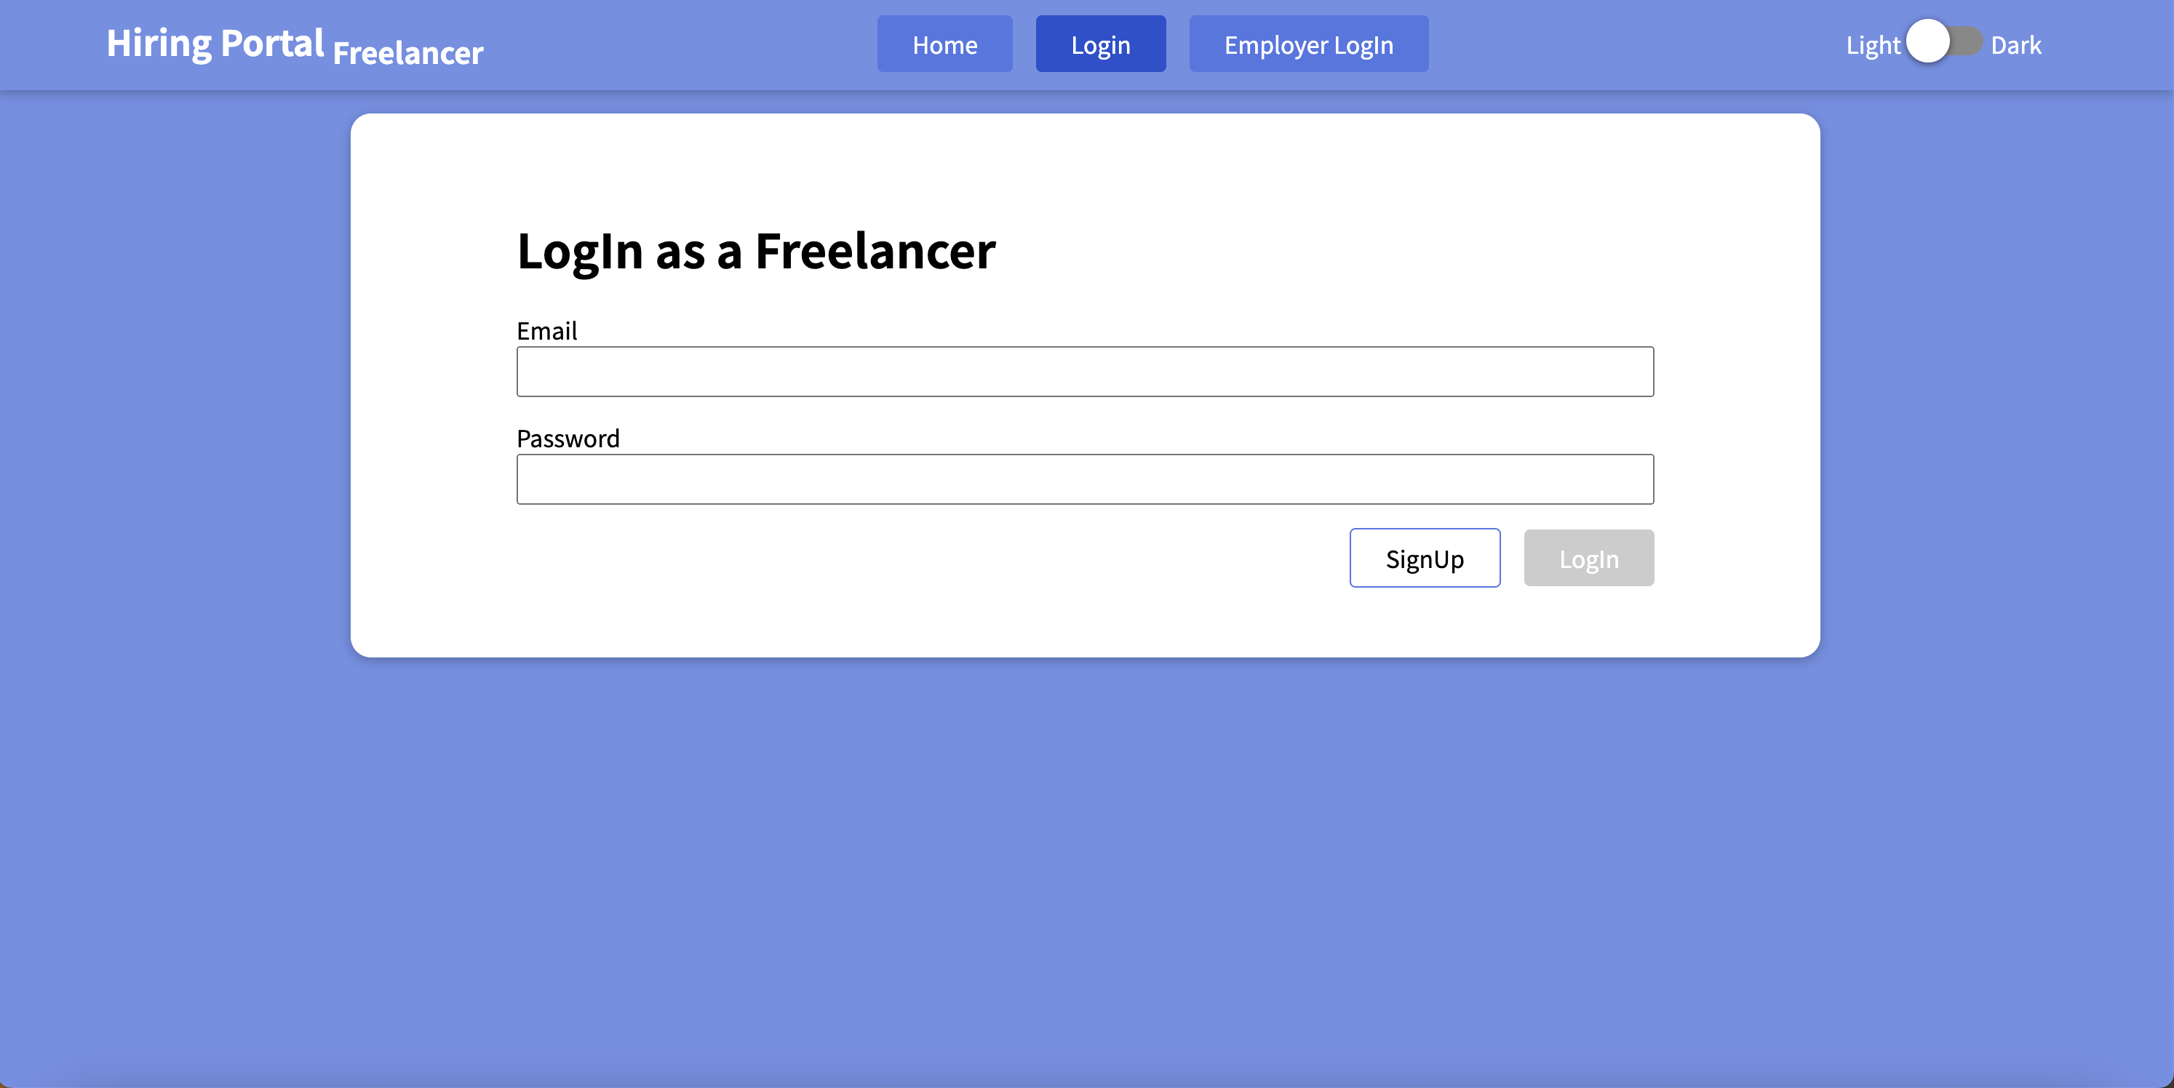
Hiring Portal Snapshots: Freelancer Login

Slide 8
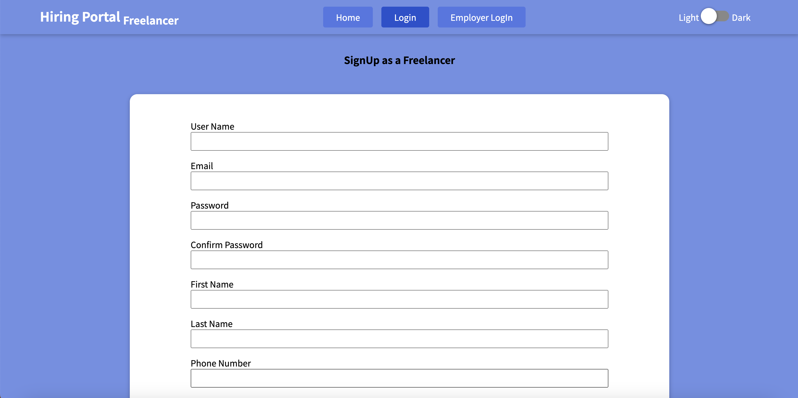
Hiring Portal Snapshots: Freelancer Sign Up

Slide 9
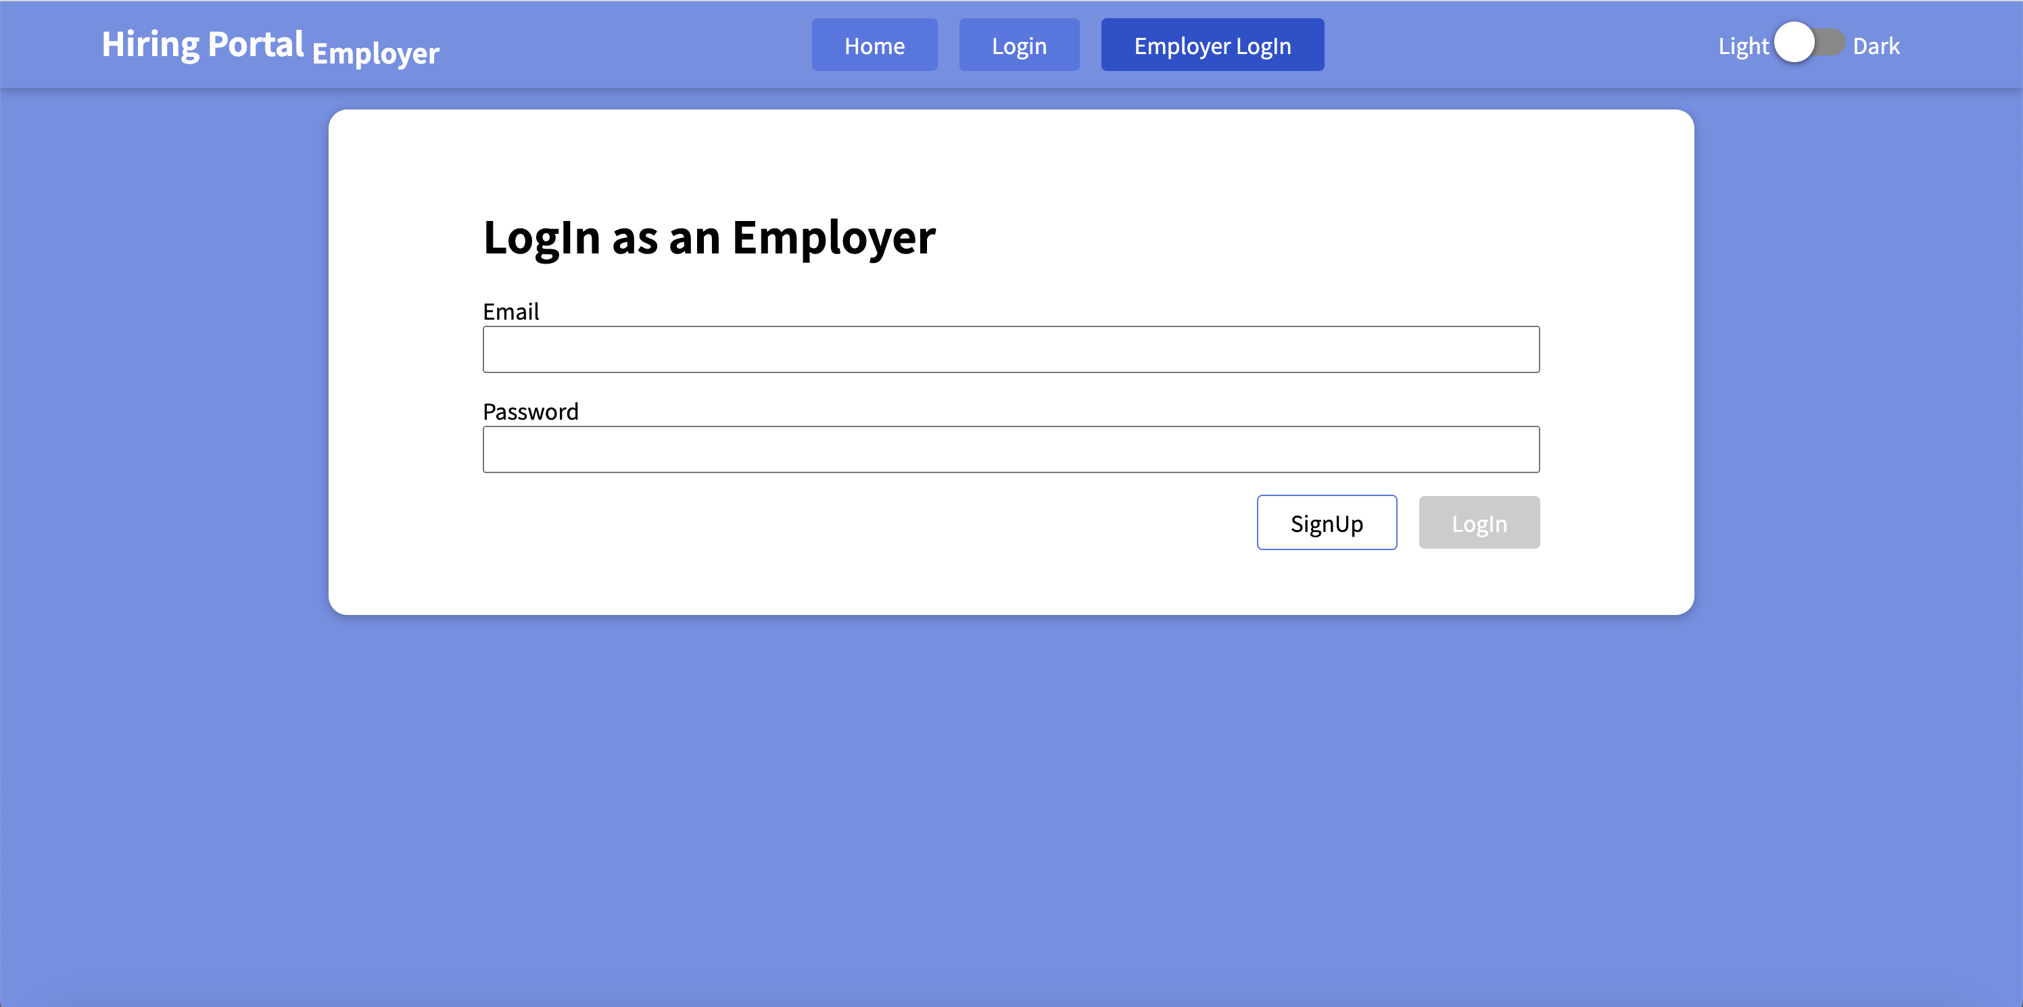
Hiring Portal Snapshots: Employer Login / Sign Up

Slide 10
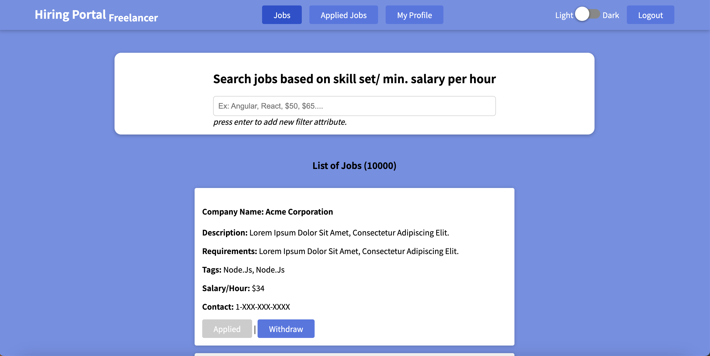
Hiring Portal Snapshots: Freelancer Dashboard

Slide 11
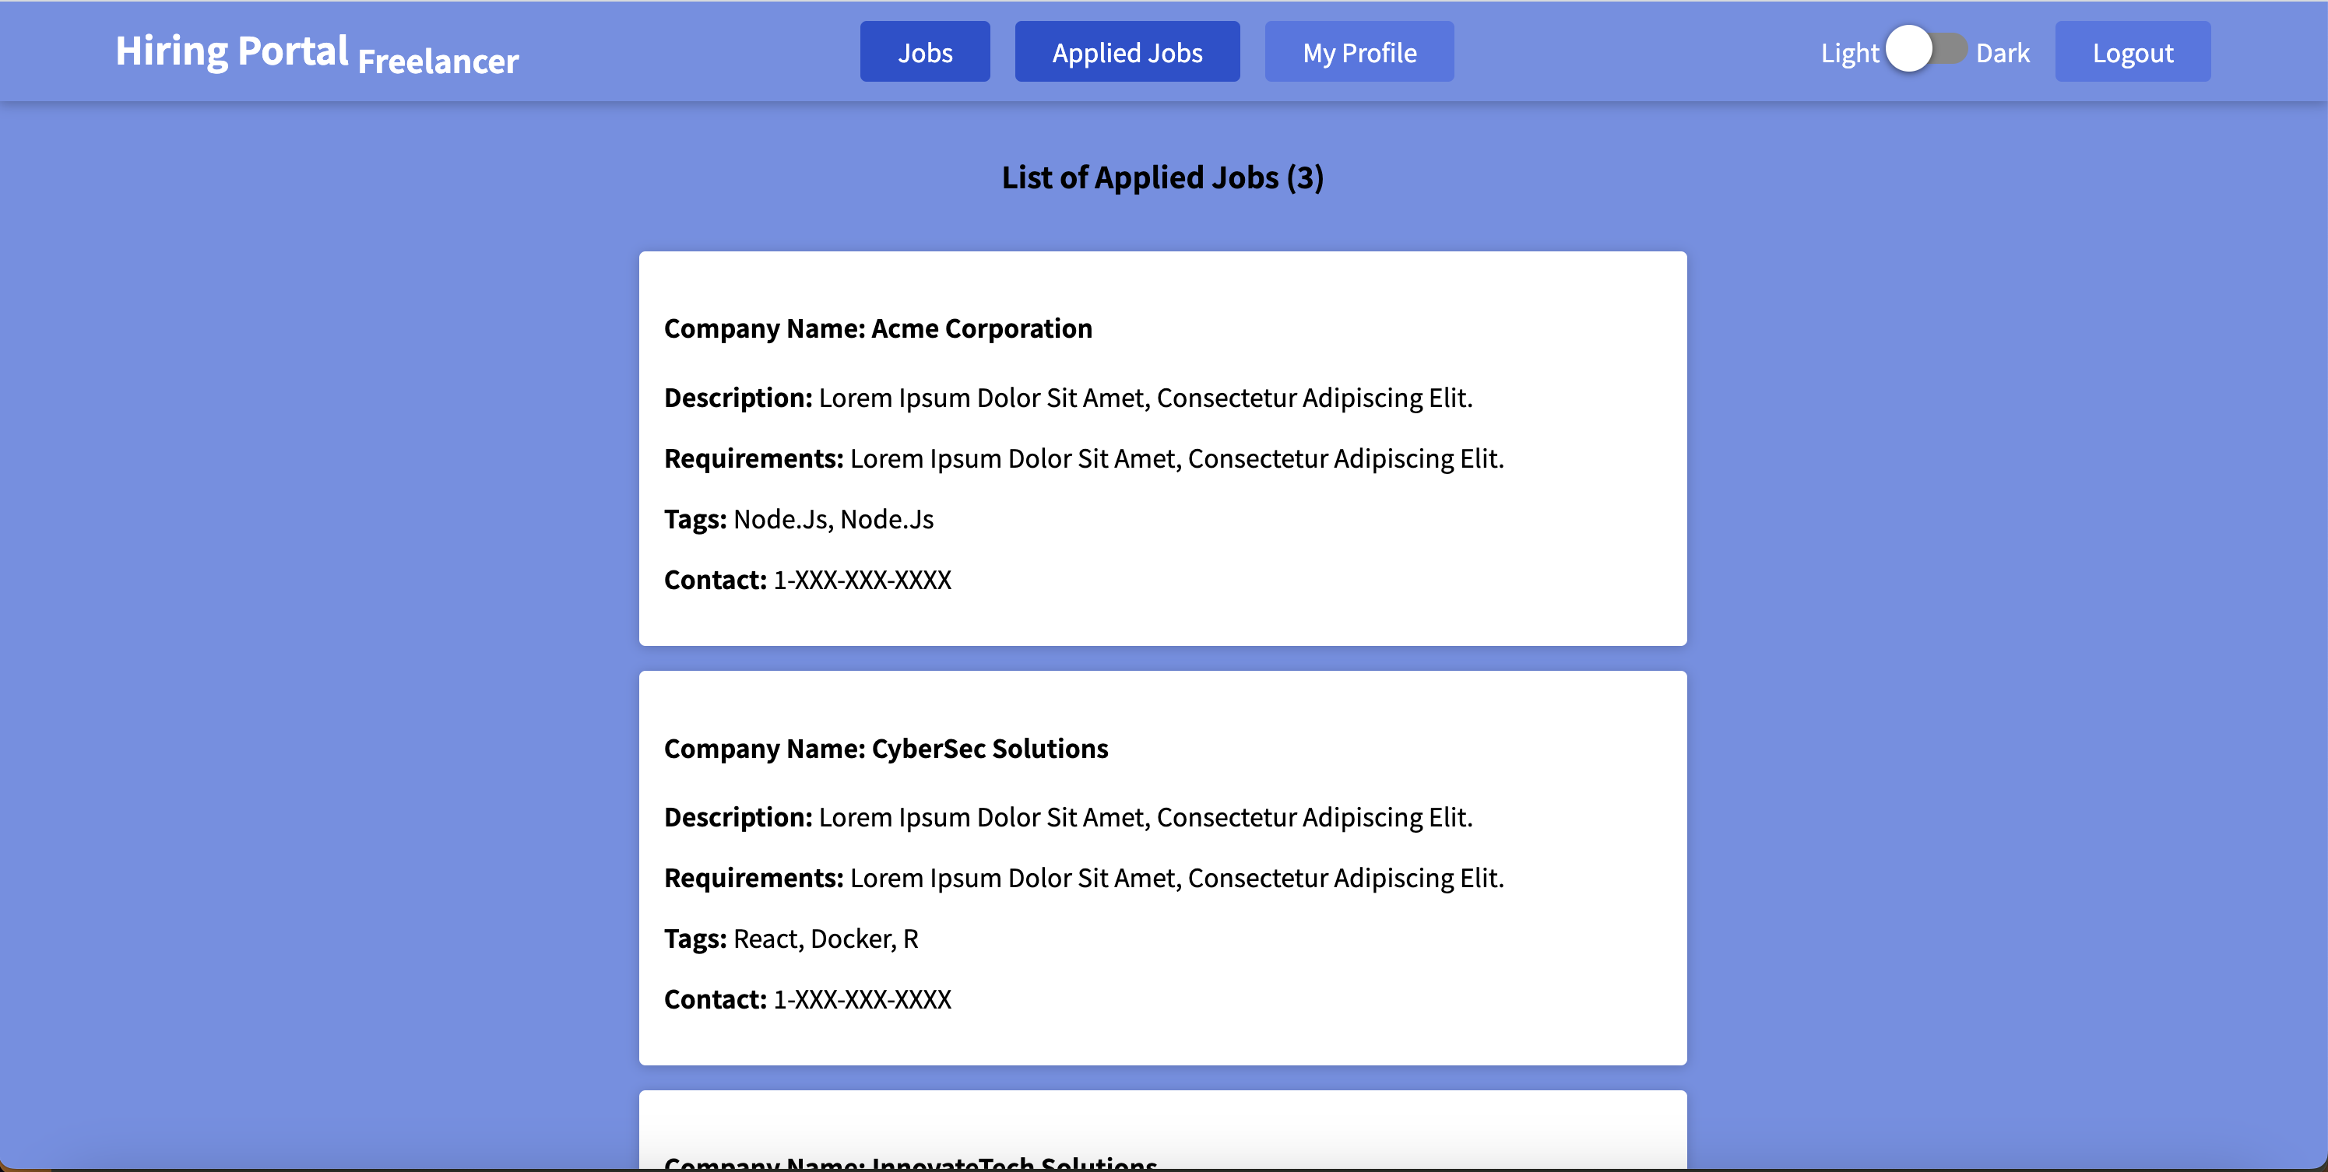
Hiring Portal Snapshots: Freelancer Applied Jobs View

Slide 12
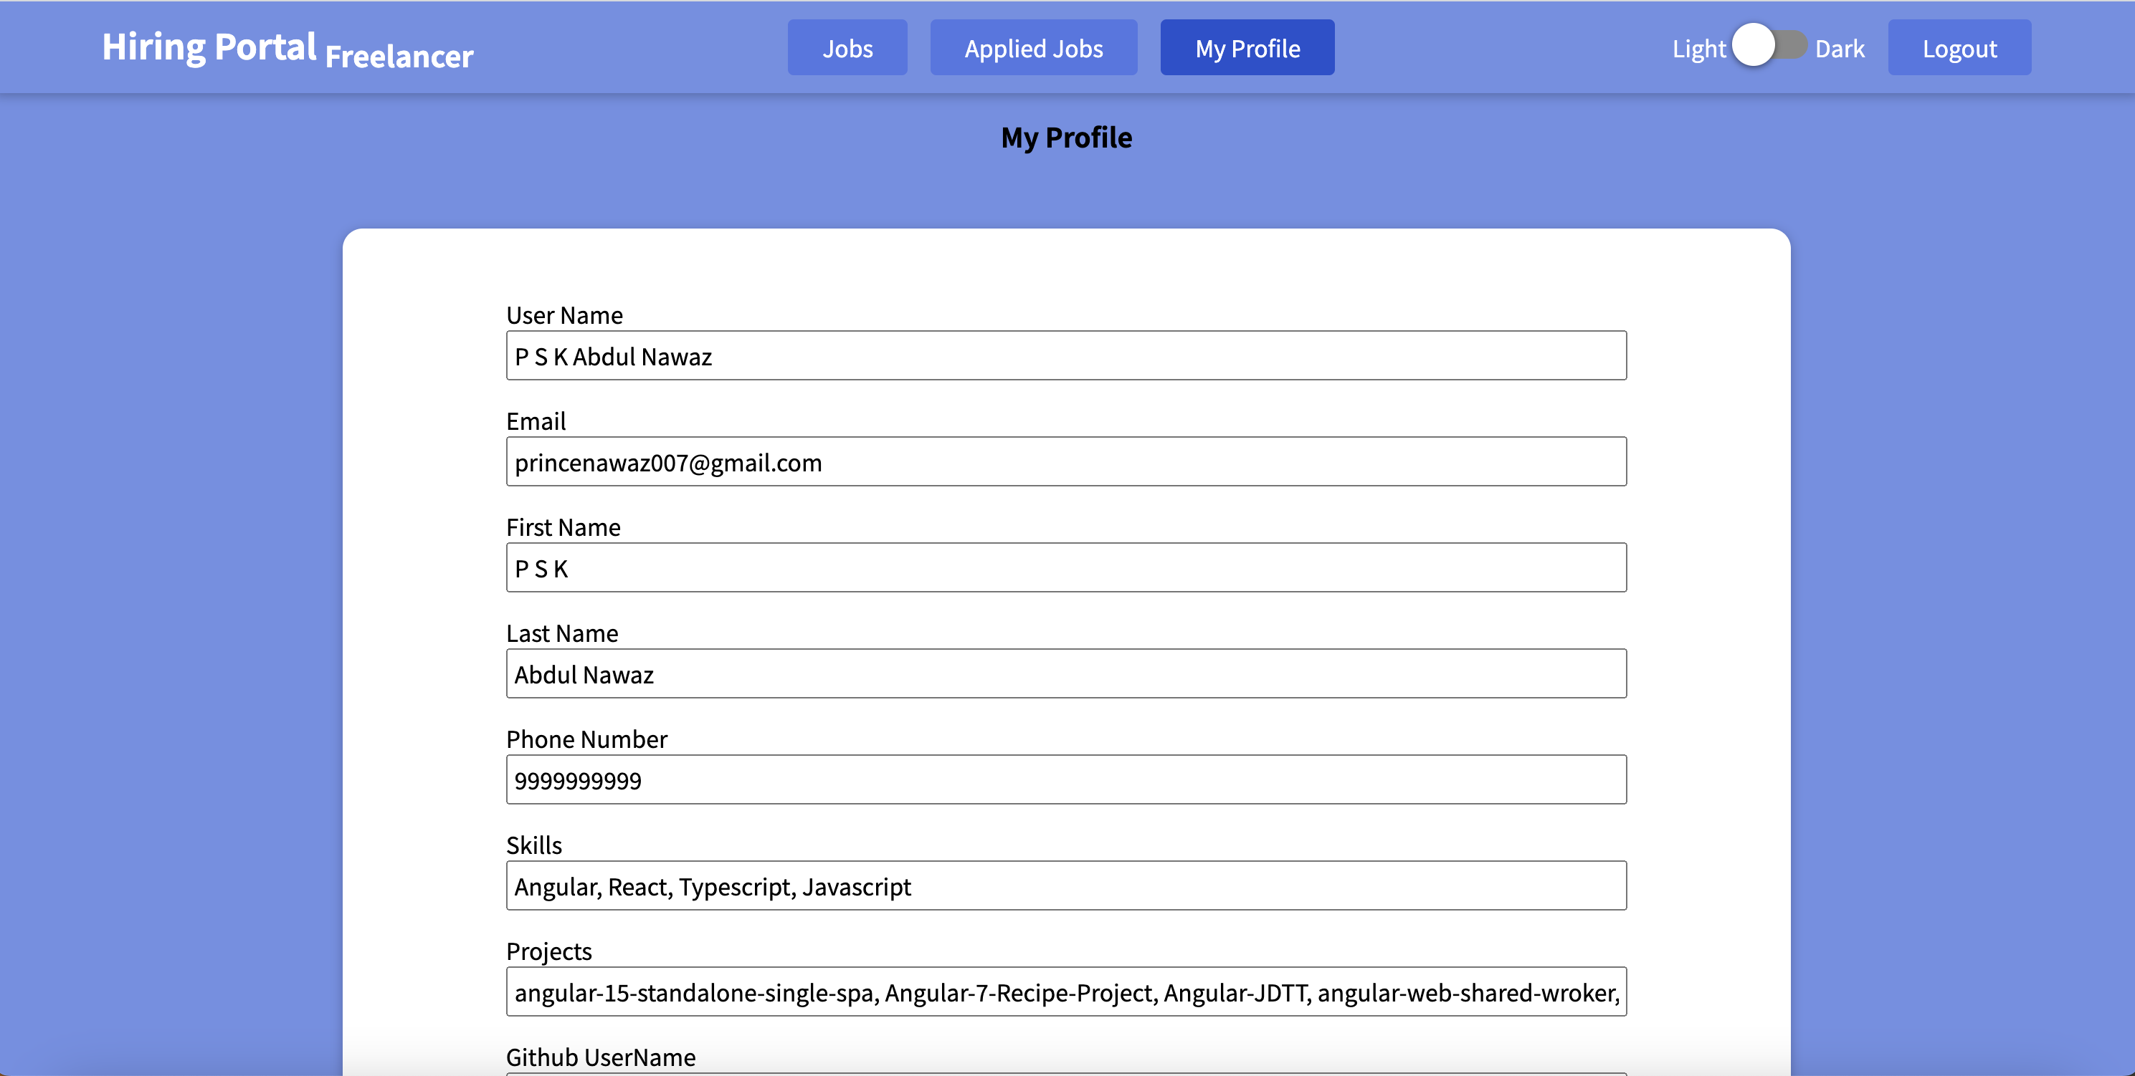
Hiring Portal Snapshots: Freelancer Profile View

Slide 13
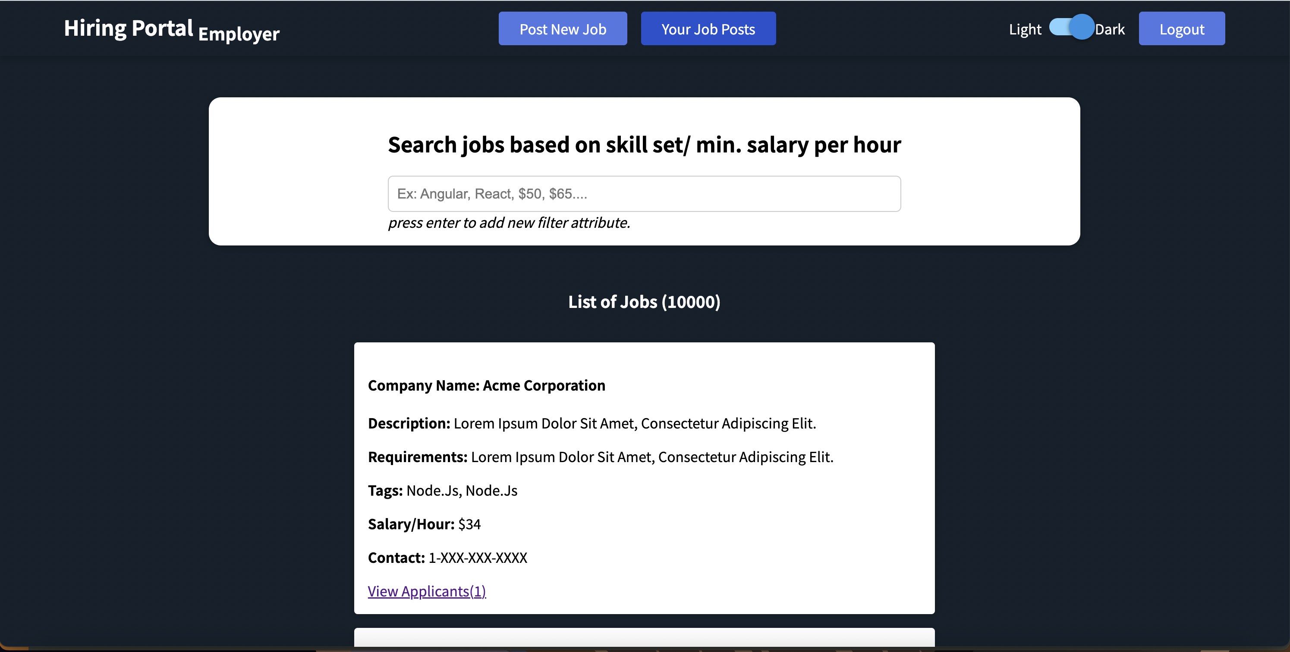
Hiring Portal Snapshots: Employer Dashboard

Slide 14
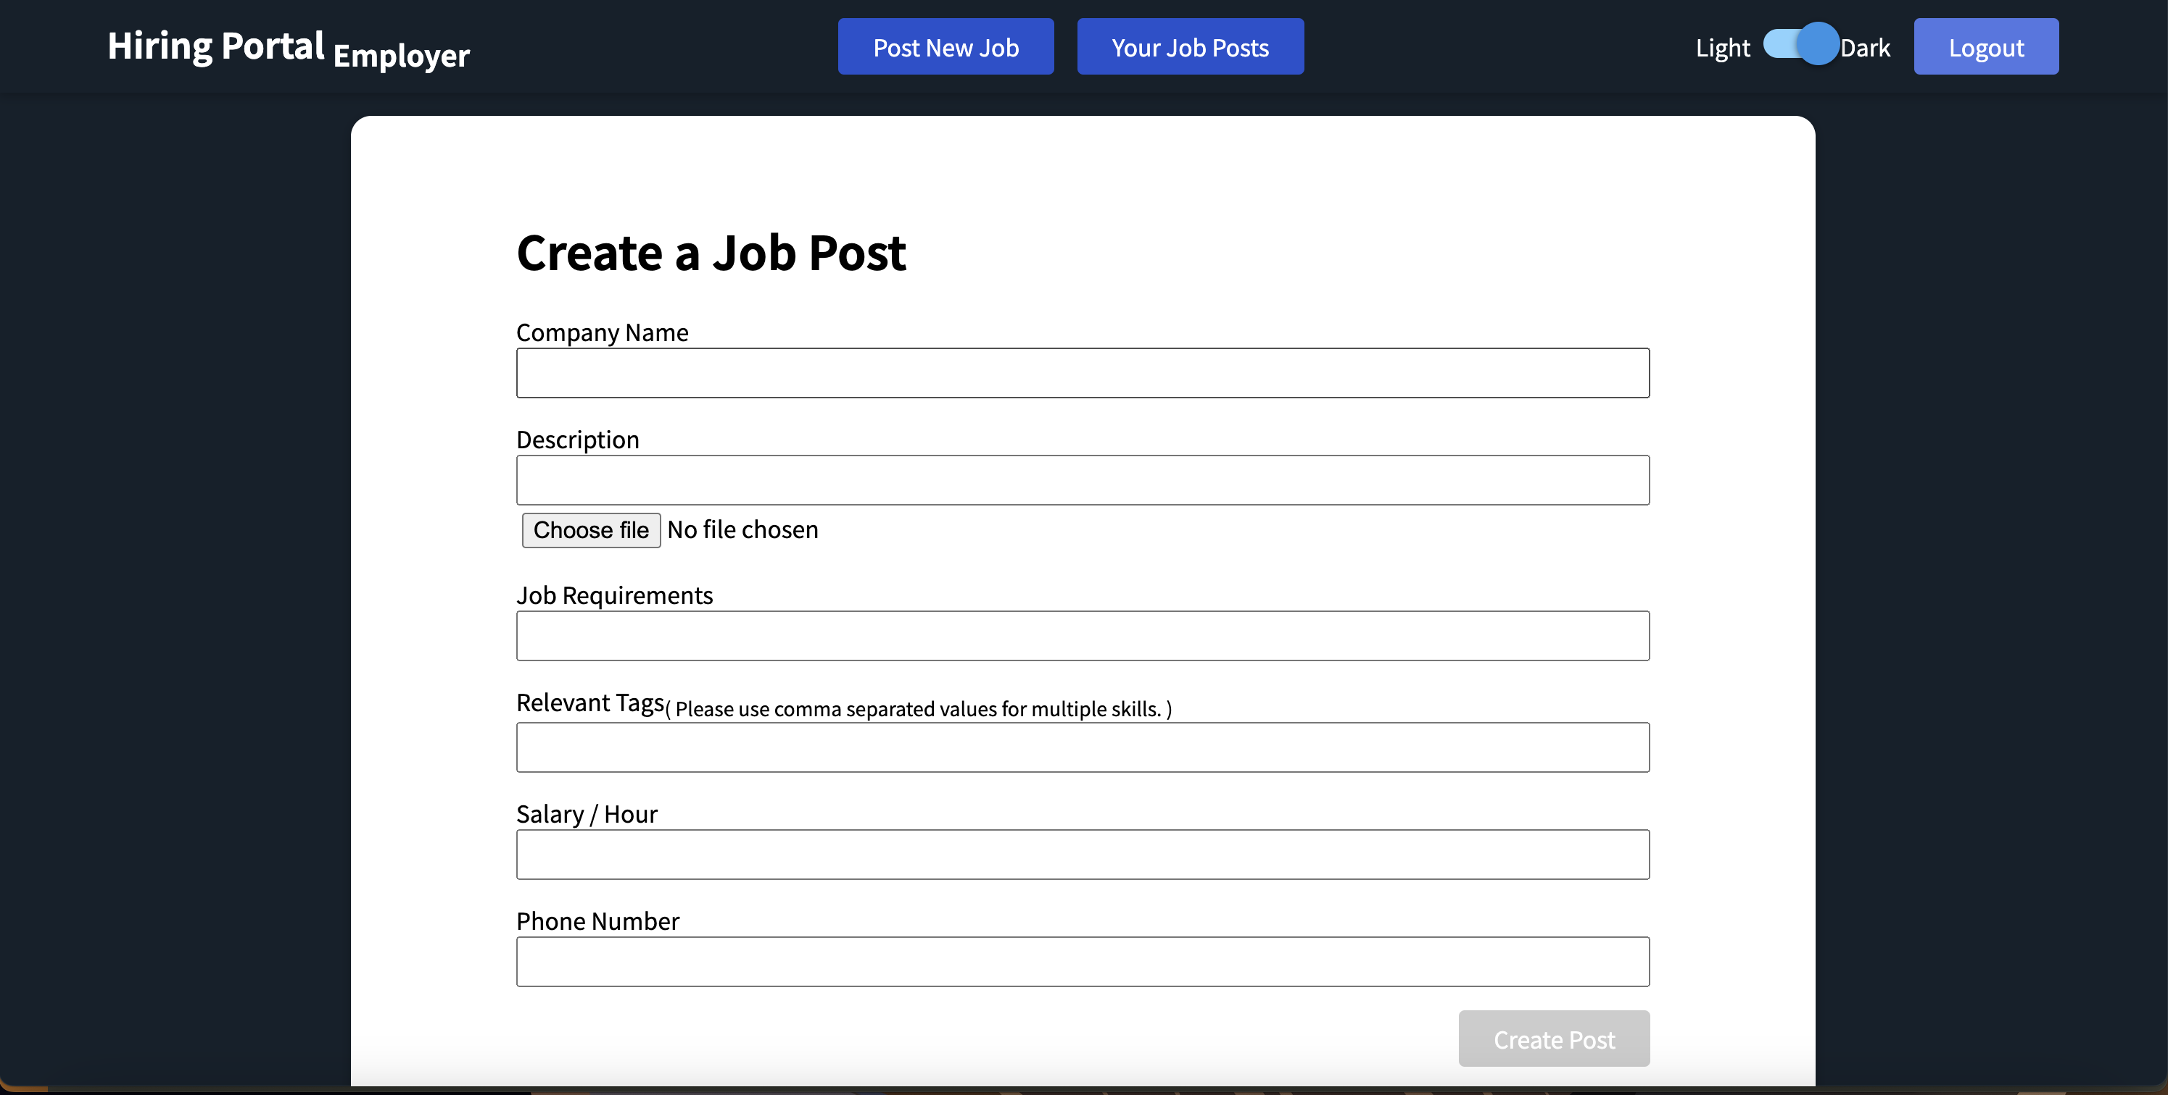
Hiring Portal Snapshots: Employer view to create new job post

Slide 15
Thank You

